Slide 1


Slide 2


STOCK MARKET ANALYSIS
PRESENTED BY
ARUNA KUMARI V

Slide 3
DISCLAIMER!!
The Stock Market Analysis conducted in this project serves for academic purposes. Please note that the stock market analysis presented in this project is based solely on my personal understanding and research gathered from Internet resources and articles. I do not possess any formal domain knowledge or expertise in the stock market

Slide 4




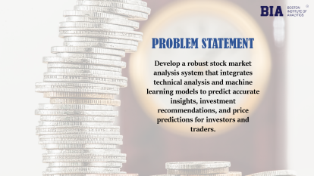

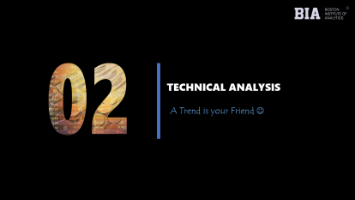
OUTLINE

Slide 5

PROBLEM STATEMENT
Develop a robust stock market analysis system that integrates technical analysis and machine learning models to predict accurate insights, investment recommendations, and price predictions for investors and traders.

Slide 6
BENEFIT OF THIS PROJECT
Investment Decision Making
Portfolio Management
Risk Assessment and Mitigation
Financial Planning

Slide 7


Slide 8



2023
The government has announced their commitment to enhancing infrastructure as part of their plan for current year.

Slide 9
2022
The government has announced their commitment to enhancing infrastructure as part of their plan for current year.
Which Sectors are impacted??

Slide 10

2022
The government has announced their commitment to enhancing infrastructure as part of their plan for current year.
Which Sectors are impacted?
Steel Industry

Slide 11

2022
The government has announced their commitment to enhancing infrastructure as part of their plan for current year.
Which Sectors are impacted?
Steel Industry
Cement Industry

Slide 12

2022
The government has announced their commitment to enhancing infrastructure as part of their plan for current year.
Which Sectors are impacted?
Steel Industry
Cement Industry
Transportation

Slide 13

2022
The government has announced their commitment to enhancing infrastructure as part of their plan for current year.
Which Sectors are impacted?
Steel Industry
Cement Industry
Transportation
Oil Industry

Slide 14

2022
The government has announced their commitment to enhancing infrastructure as part of their plan for current year.
Which Sectors are impacted?
Steel Industry
Cement Industry
Transportation
Telecom
Oil Industry

Slide 15

2022
The government has announced their commitment to enhancing infrastructure as part of their plan for current year.
Which Sectors are impacted?
Steel Industry
Cement Industry
Telecom
Transportation
Oil Industry
Real Estate

Slide 16

2022
The government has announced their commitment to enhancing infrastructure as part of their plan for current year.
Which Sectors are impacted?
Steel Industry
Cement Industry
Transportation
Oil Industry
Telecom
Real Estate

Slide 17

2022
The government has announced their commitment to enhancing infrastructure as part of their plan for current year.
Which Sectors are impacted?
Steel Industry
Sector is selected

Slide 18









2022
The government has announced their commitment to enhancing infrastructure as part of their plan for current year.

Slide 19

2022
The government has announced their commitment to enhancing infrastructure as part of their plan for current year.
1
Technical Analysis
2
Predicting Stock price using Machine Learning

Slide 20

EXPLORATORY DATA ANALYSIS
NIFTY 50 STOCK DATASET
DATA SOURCE - Yahoo Finance

Slide 21

NIFTY 50 STOCK DATASET
DATA SOURCE - Yahoo Finance
EXPLORATORY DATA ANALYSIS
ABOUT DATASET
The NIFTY 50 is a stock market index in India that represents the performance of the top 50 companies listed on the National Stock Exchange (NSE). The NIFTY 50 dataset typically contains historical data of the 50 constituent companies.

Slide 22
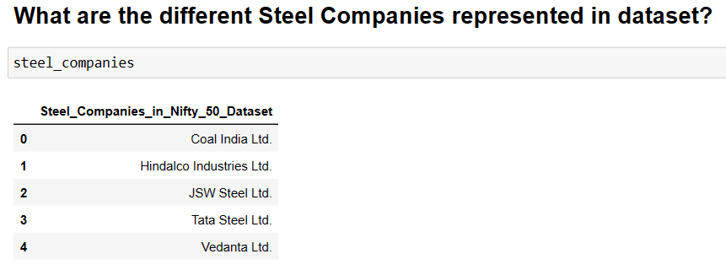

Slide 23
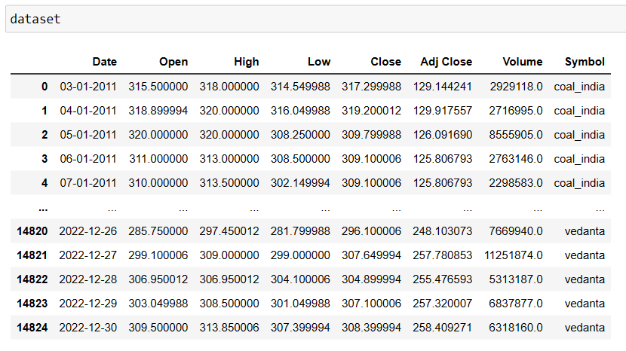
From the Year 2011 – 2022

Slide 24
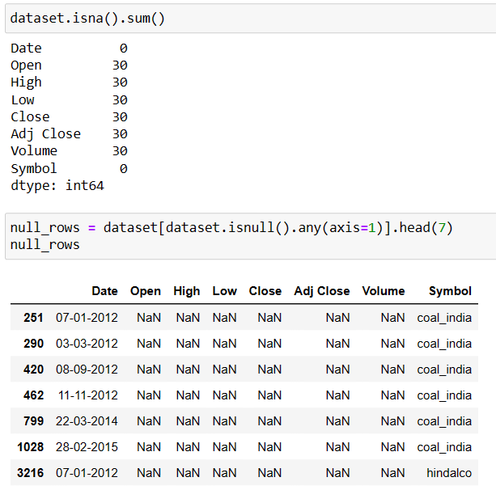
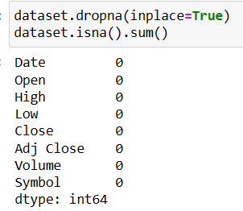
Null Values
The occurrence of dates fell on weekends and festival holidays!!
From the Year 2011 – 2022
Solution – Drop null values

Slide 25
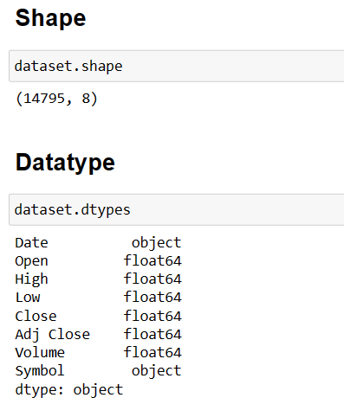
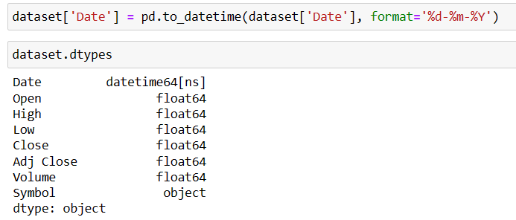
Shape and Data type
Null Values
Solution – Change data type to datetime
The occurrence of dates fell on weekends and festival holidays!!
From the Year 2011 – 2022
Solution – Drop null values

Slide 26
Shape and Data type
Describe()
Null Values
The occurrence of dates fell on weekends and festival holidays!!
Company | Standard Deviation
Coal India | 79.22
HindalCo | 112.99
JSW Steel | 200.44
Tata Steel | 28.63
Vedanta | 74.60
Insight
From the Year 2011 – 2022
Solution – Drop null values
JSW Steel has high dispersion of data and Tata Steel has low data dispersion

Slide 27
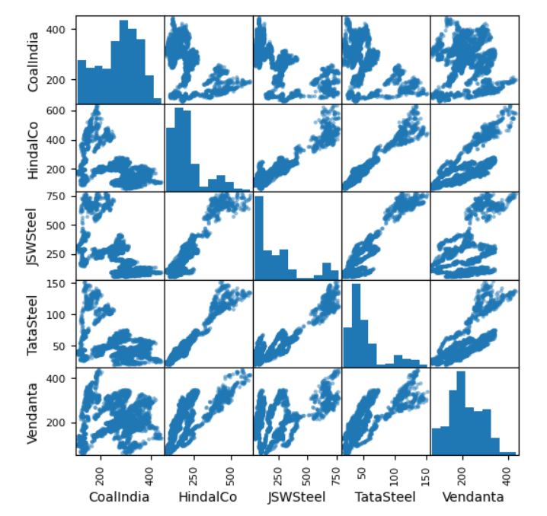
Shape and Data type
Null Values
Correlation
Describe()
JSW Steel and HindalCo
The occurrence of dates fell on weekends and festival holidays!!
Insight
Company | Standard Deviation
Coal India | 79.22
HindalCo | 112.99
JSW Steel | 200.44
Tata Steel | 28.63
Vedanta | 74.60
From the Year 2011 – 2022
JSW Steel is correlated with HindalCo and Tata Steel
Insight
Solution – Drop null values
JSW Steel and Tata Steel
JSW Steel has high dispersion of data and Tata Steel has low data dispersion
Tata Steel is correlated with HindalCo
Tata Steel and HindalCo
This analysis helps in Portfolio Diversification

Slide 28

TECHNICAL ANALYSIS
A Trend is your Friend ☺

Slide 29
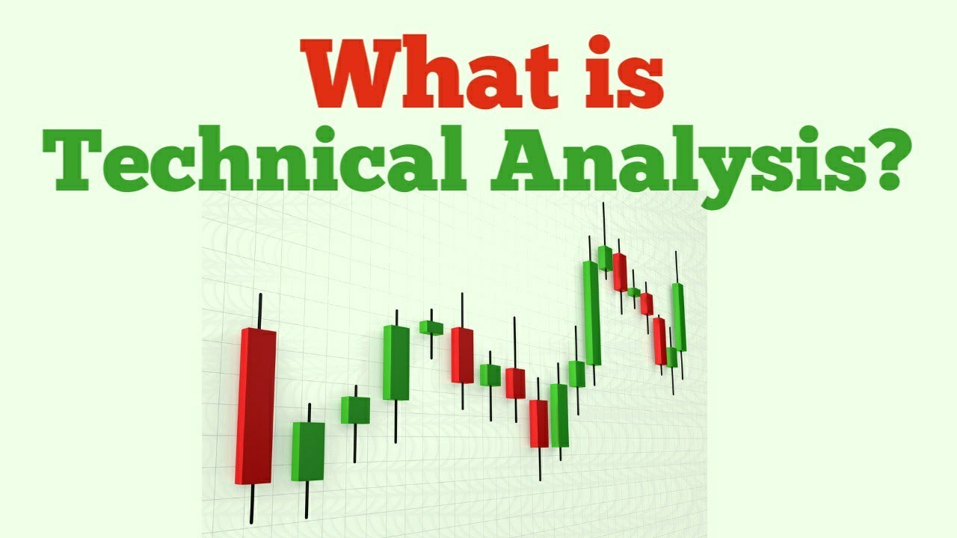
TECHNICAL ANALYSIS
Technical Analysis aims to predict future price movements and make trading decision based on historical market data, primarily focusing on price and volume patterns, chart patterns and technical indicators.

Slide 30
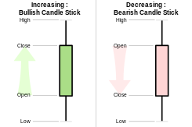
TECHNICAL ANALYSIS
Candle Stick Charts
Technical Analysis aims to predict future price movements and make trading decision based on historical market data, primarily focusing on price and volume patterns, chart patterns and technical indicators.

Slide 31
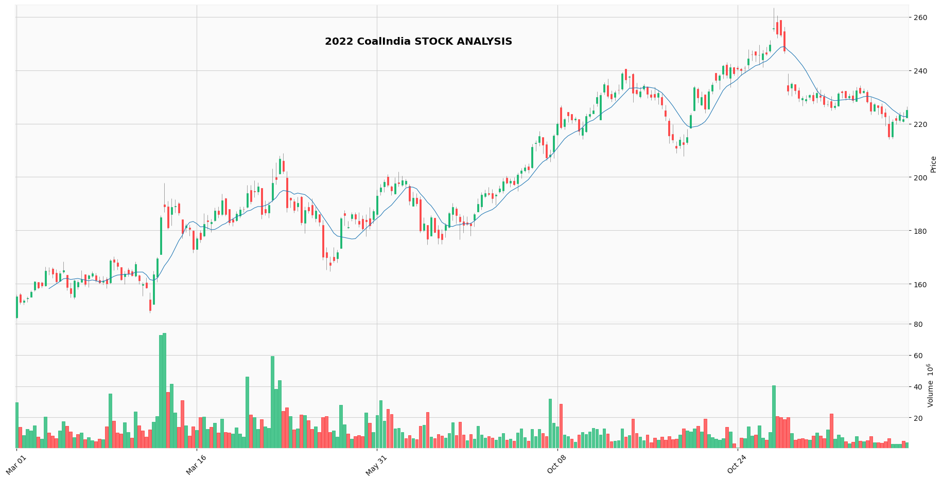
Candle Stick Charts
UP - Trend
July to Oct

Slide 32
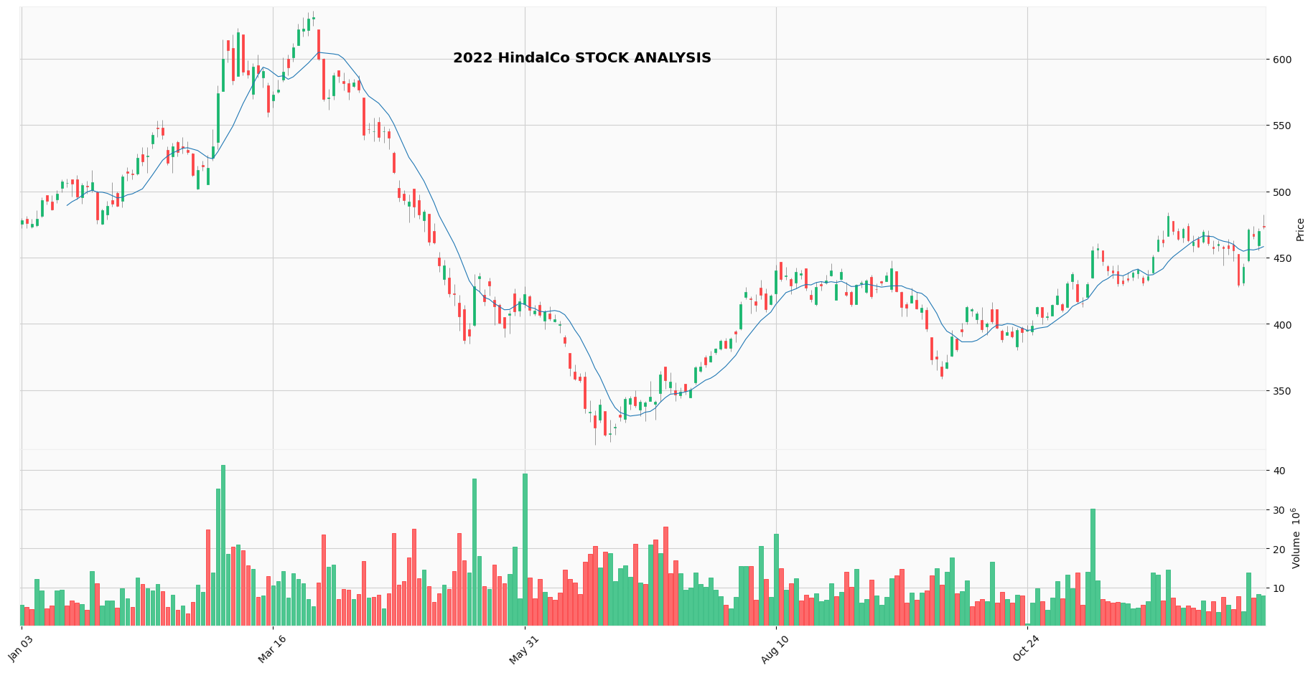
Down - Trend
Mar to May
Sideways - Trend
Aug to Oct

Slide 33
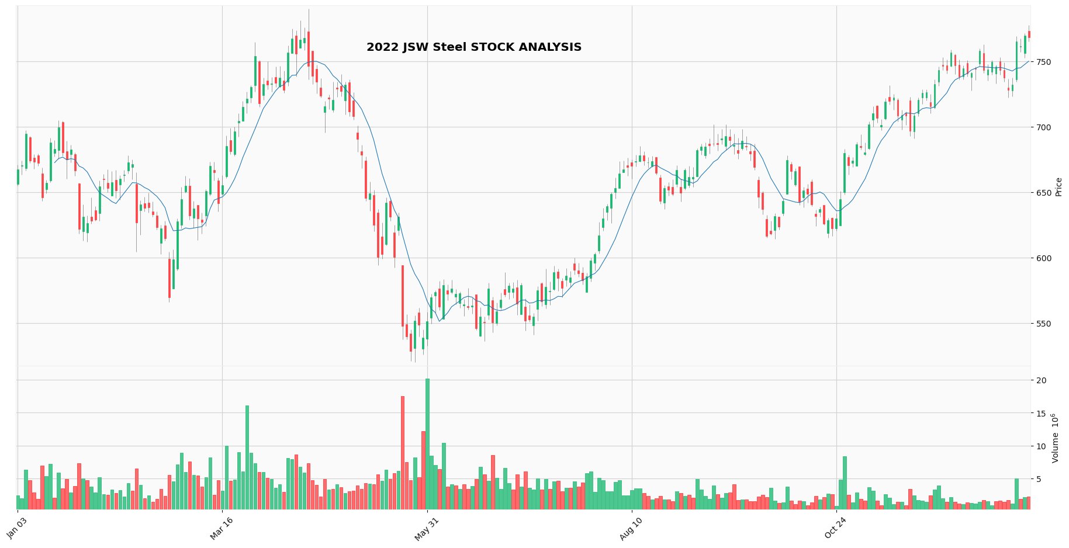
Aug to Oct (Common)
Down - Trend
Mar to May (Common)
Sideways - Trend

Slide 34
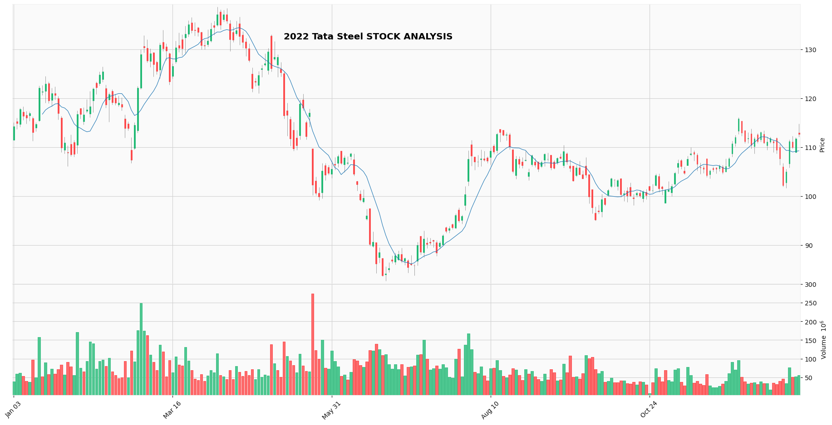
Down - Trend
Aug to Oct (Common)
Mar to May (Common)
Sideways - Trend

Slide 35
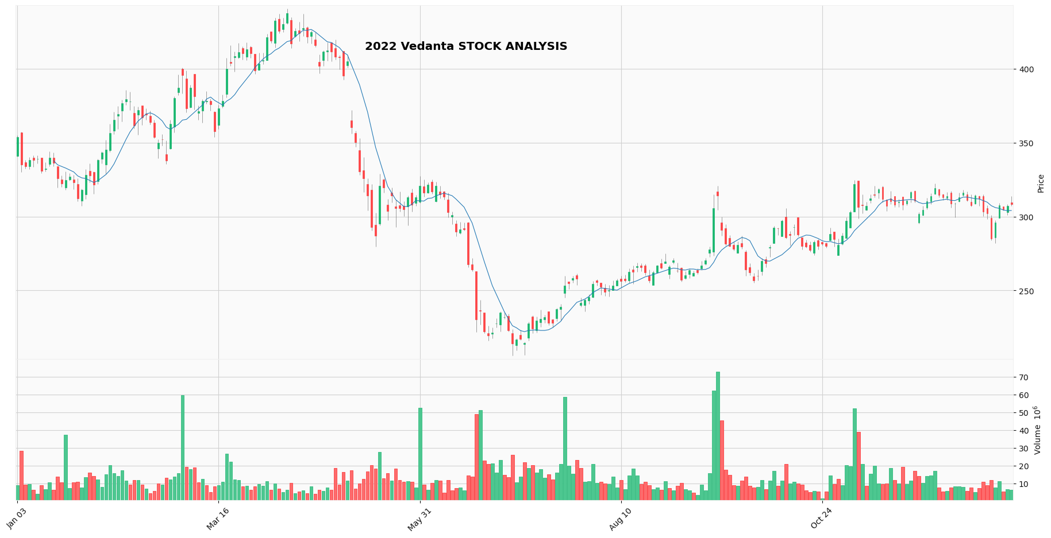
Mar to May (Common)
Down - Trend
Aug to Oct (Common)
Sideways - Trend

Slide 36
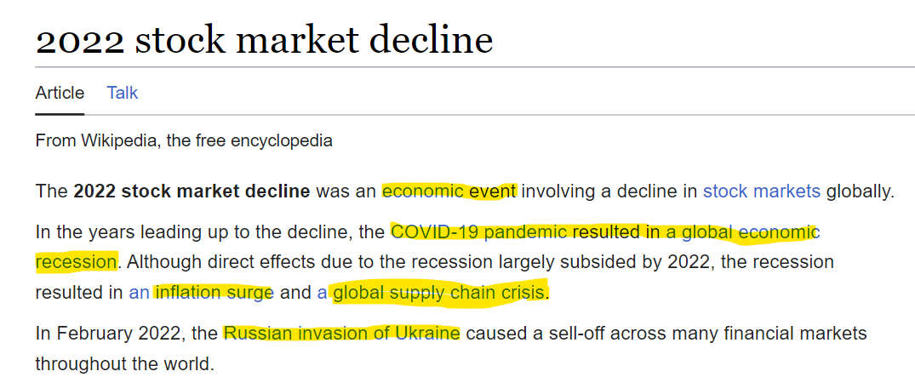

Slide 37
Insight
Based on past data, we found a Common Trend in all Steel Companies except Coal India Ltd
Economic crisis affected all Steel Companies except Coal India Ltd
Coal India‘s ability to withstand the economic crisis may position it as a Safe Haven Investment

Slide 38
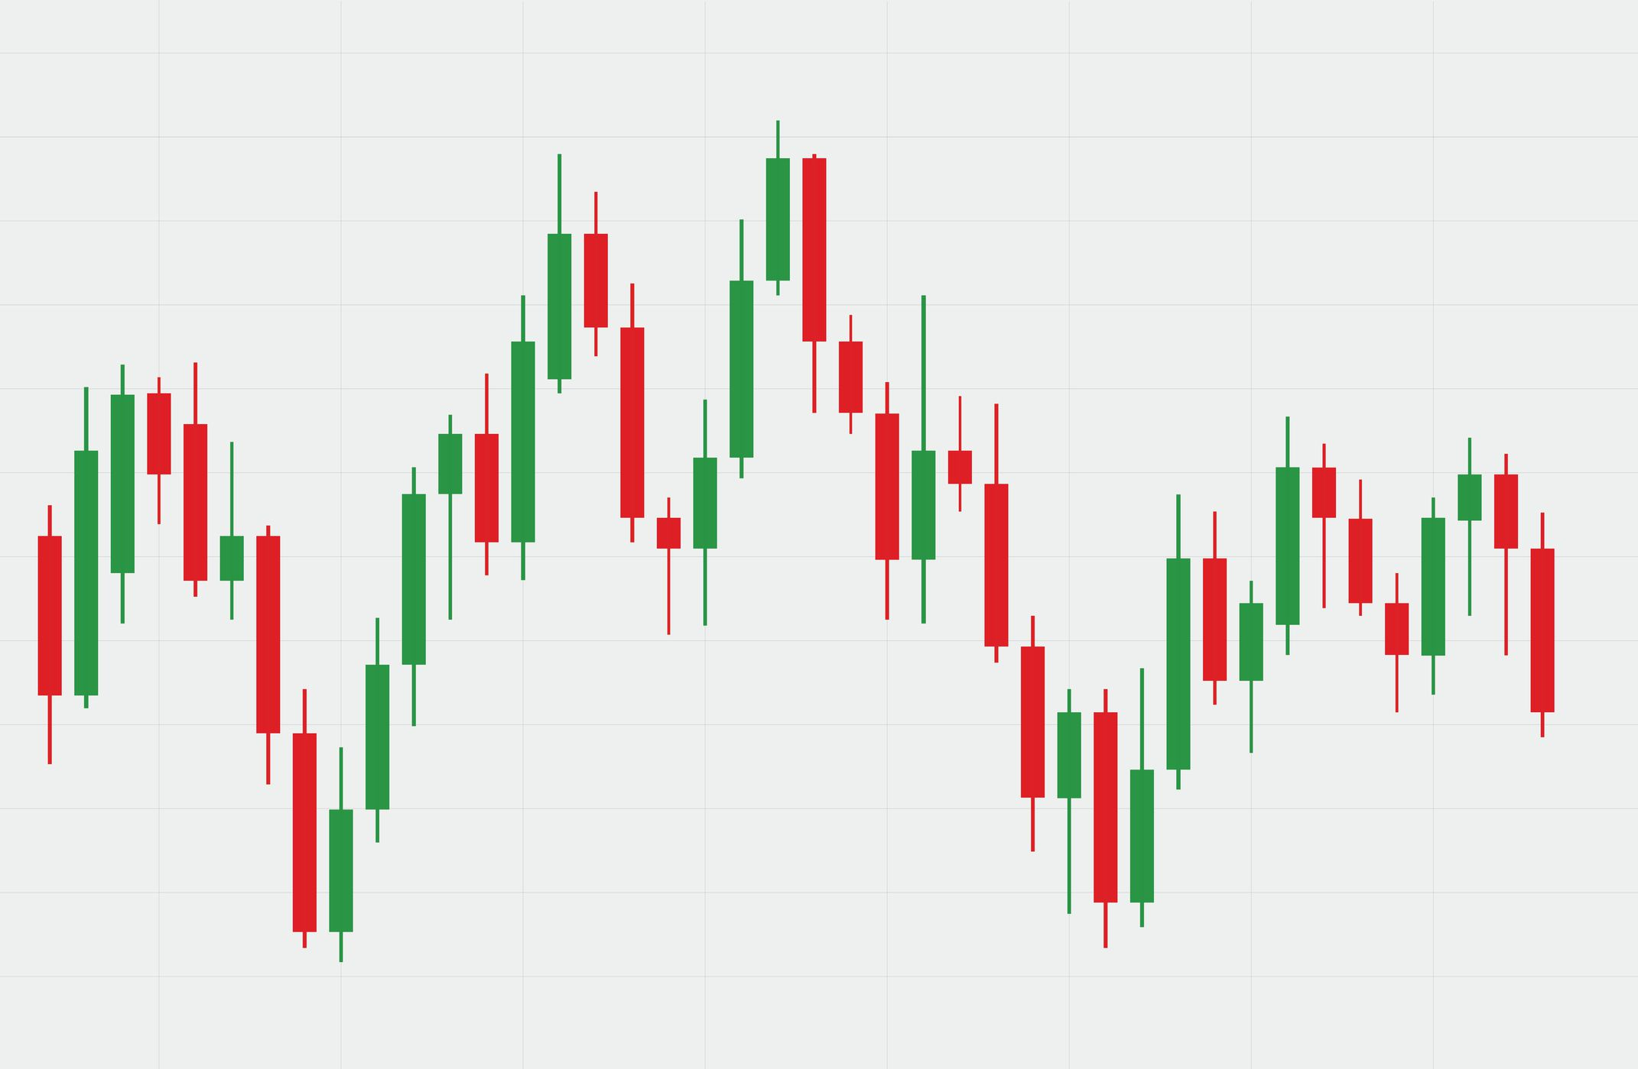
Morning and Evening Star pattern
UP - Trend
Morning Star Pattern
Evening Star Pattern
Down - Trend

Slide 39
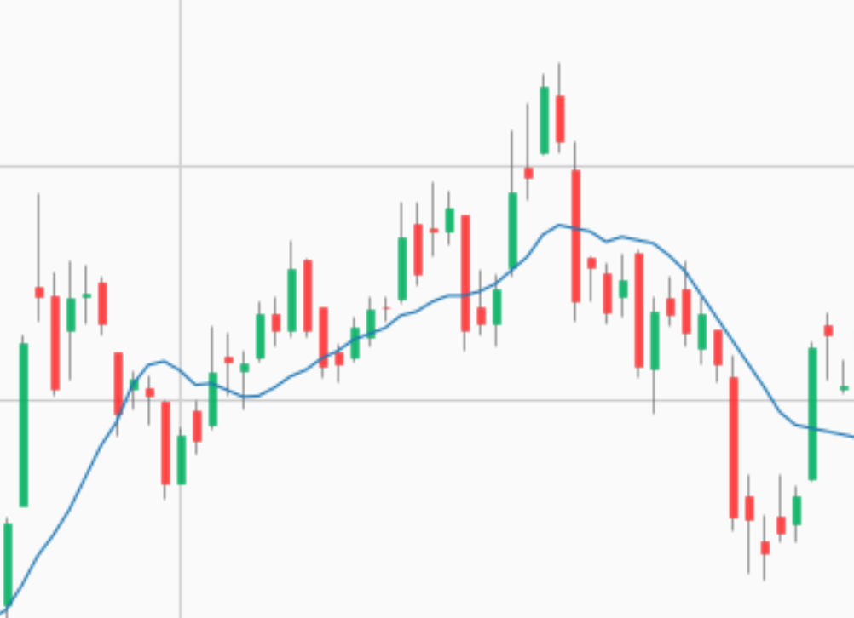
Morning and Evening Star pattern
Coal India
UP - Trend
Morning Star Pattern

Slide 40
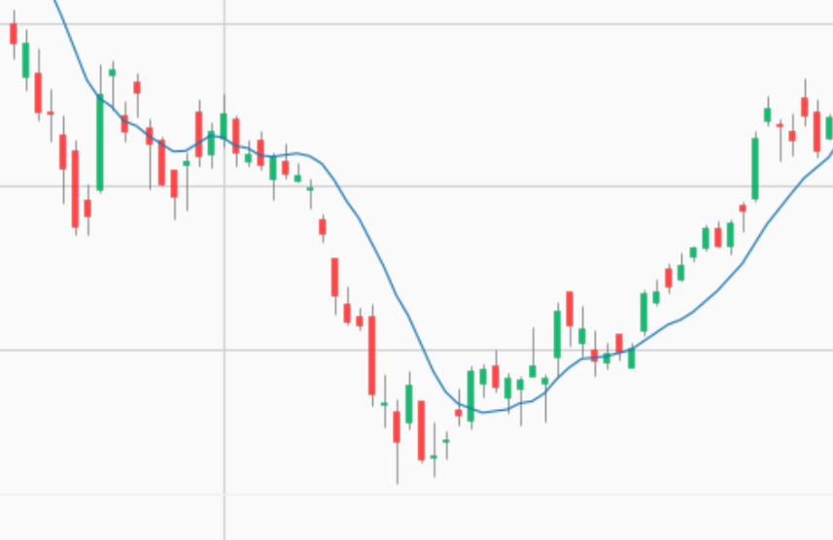
Morning and Evening Star pattern
Hindal Co
Down - Trend
Evening Star Pattern
Insight
Morning and Evening Star Pattern helps in Inta-day and short term trading

Slide 41
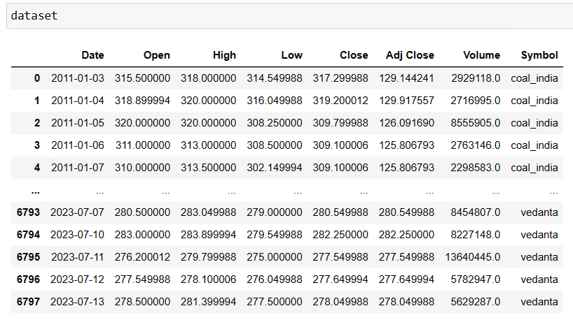
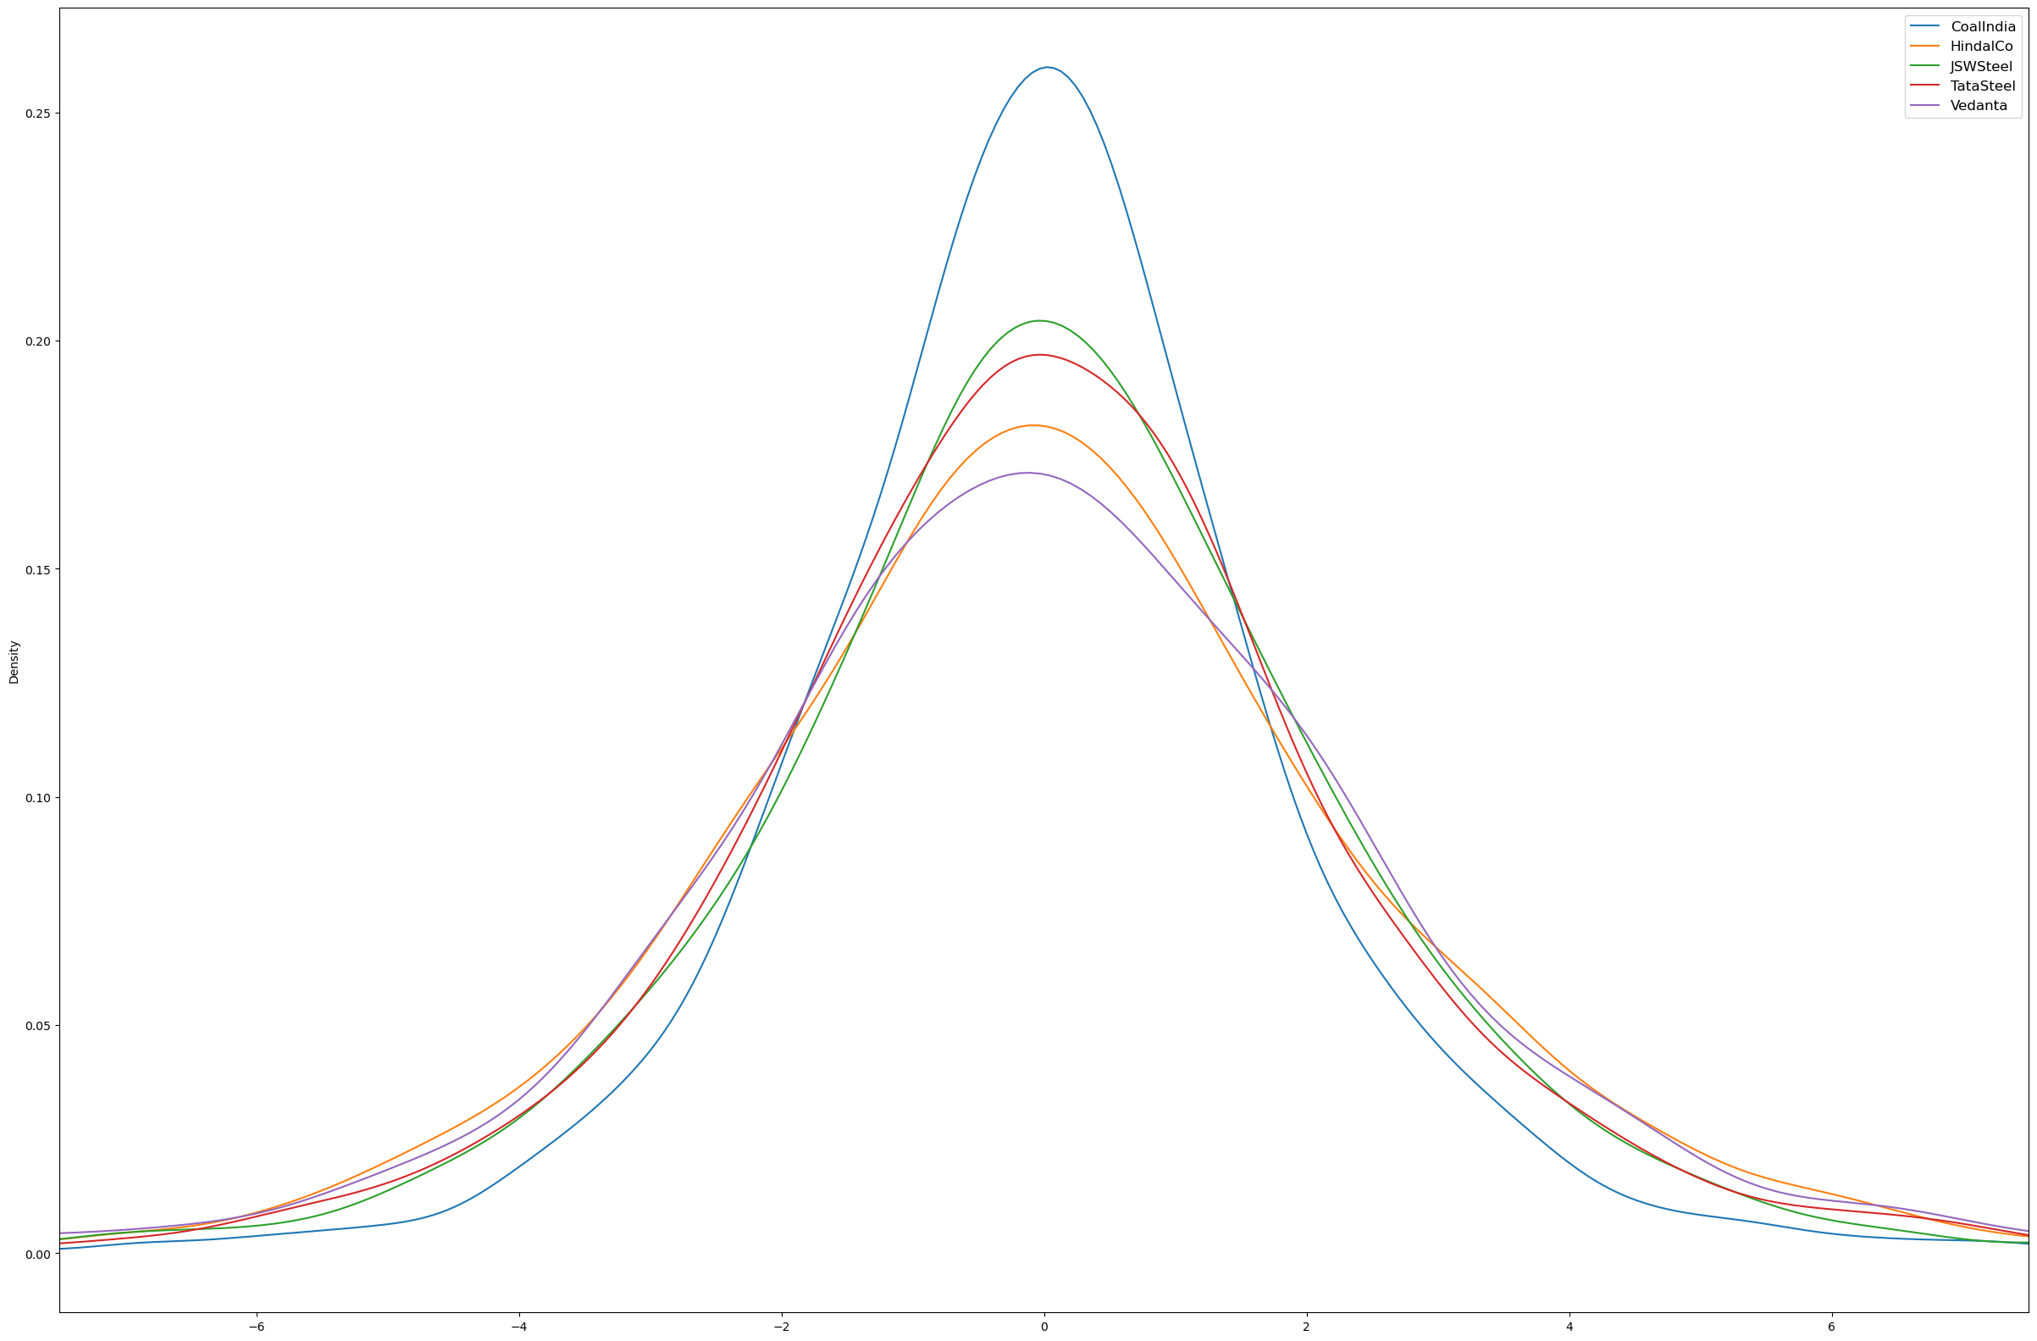
% Change
Variability
Volatility
Risk
Wider bell curve indicates a larger standard deviation, suggesting that the data points are more spread out from the mean. This implies greater variability in the data
Company | Standard Deviation
Coal India | 1.92
HindalCo | 2.60
JSW Steel | 2.40
Tata Steel | 2.38
Vedanta | 2.84
From the Year 2011 – 2022
Insight
Coal India has low Volatility and low level of Risk
%Change = (Today close price/prev close price) -1
vedanta has high Volatility and high level of risk

Slide 42
% Change
Moving Average Strategy
Variability
Volatility
Risk
Wider bell curve indicates a larger standard deviation, suggesting that the data points are more spread out from the mean. This implies greater variability in the data
Company | Standard Deviation
Coal India | 1.92
HindalCo | 2.60
JSW Steel | 2.40
Tata Steel | 2.38
Vedanta | 2.84
It Involves the calculation and use of moving averages to identify trends and potential trading signals. Moving Averages are Statistical tools that smooth out price data over a specific time period, helping traders spot patterns and trends more easily.
If Current Close < 20 day sma < 50 day sma < 200 day sma – BUY Signal
If Current Close > 20 day sma > 50 day sma > 200 day sma – SELL Signal
From the Year 2011 – 2022
Insight
Coal India has low Volatility and low level of Risk
%Change = (Today close price/prev close price) -1
vedanta has high Volatility and high level of risk

Slide 43
% Change
Moving Average Strategy
Variability
Volatility
Risk
Wider bell curve indicates a larger standard deviation, suggesting that the data points are more spread out from the mean. This implies greater variability in the data
Company | Standard Deviation
Coal India | 1.92
HindalCo | 2.60
JSW Steel | 2.40
Tata Steel | 2.38
Vedanta | 2.84
It Involves the calculation and use of moving averages to identify trends and potential trading signals. Moving Averages are Statistical tools that smooth out price data over a specific time period, helping traders spot patterns and trends more easily.
If Current Close < 20 day sma < 50 day sma < 200 day sma – BUY Signal
If Current Close > 20 day sma > 50 day sma > 200 day sma – SELL Signal
From the Year 2011 – 2022
Insight
Coal India has low Volatility and low level of Risk
%Change = (Today close price/prev close price) -1
vedanta has high Volatility and high level of risk

Slide 44
Moving Average Strategy
Moving Average Crossover Strategy
If the short term sma crosses the long term sma from below – BUY Signal
If the short term sma crosses the long term sma from above – SELL Signal
It Involves the calculation and use of moving averages to identify trends and potential trading signals. Moving Averages are Statistical tools that smooth out price data over a specific time period, helping traders spot patterns and trends more easily.
From the Year 2011 – 2022

Slide 45
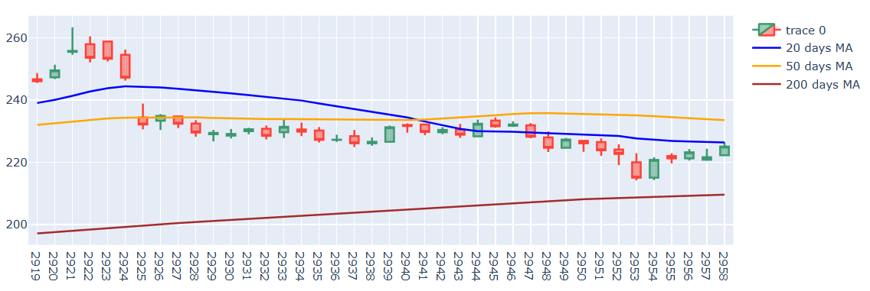
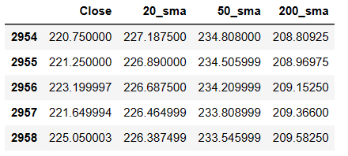
Moving Average Crossover Strategy
Coal India
Predicting for 2023
SELL Signal
Short term crossing long term from above
From the Year 2011 – 2022
BUY/SELL Signal!!

Slide 46
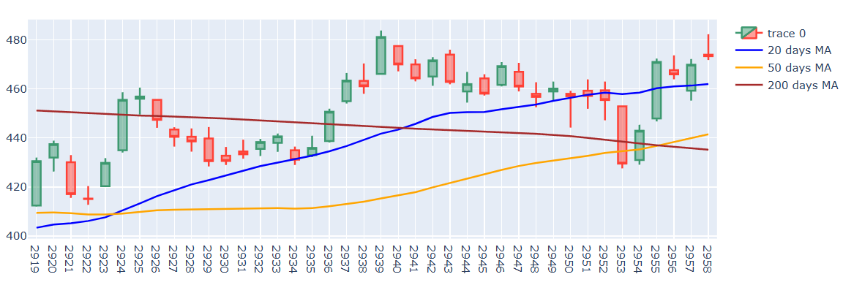
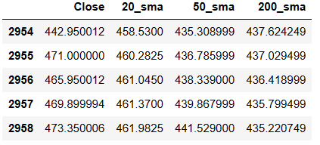
Moving Average Crossover Strategy
HindalCo
Predicting for 2023
From the Year 2011 – 2022
BUY Signal
Short term crossing long term from below
BUY Signal
BUY/SELL Signal!!
Short term crossing long term from below

Slide 47
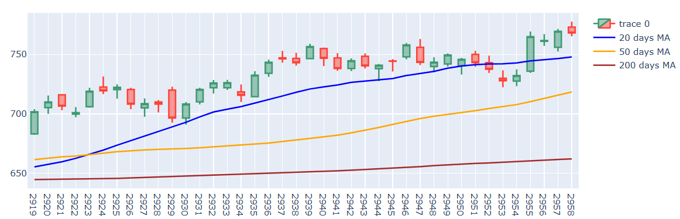
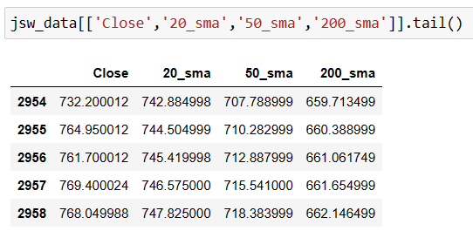
Moving Average Crossover Strategy
JSW Steel
Predicting for 2023
From the Year 2011 – 2022
Short term crossing long term from below
BUY Signal
SELL Signal!!

Slide 48
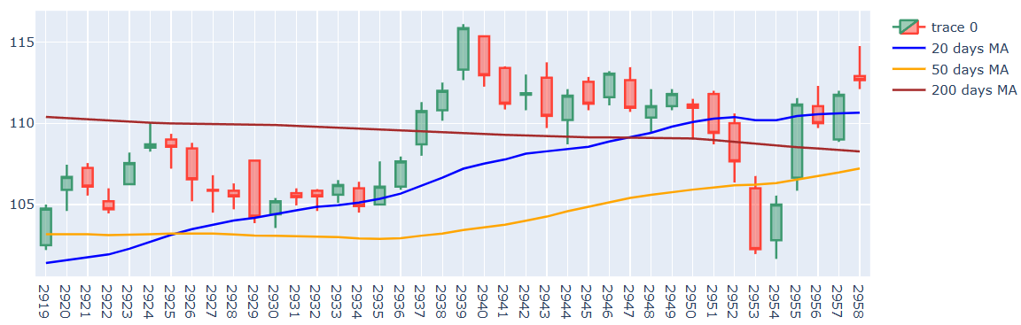
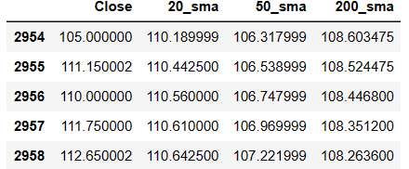
Moving Average Crossover Strategy
Tata Steel
Predicting for 2023
From the Year 2011 – 2022
Short term crossing long term from below
BUY Signal
BUY Signal!!

Slide 49
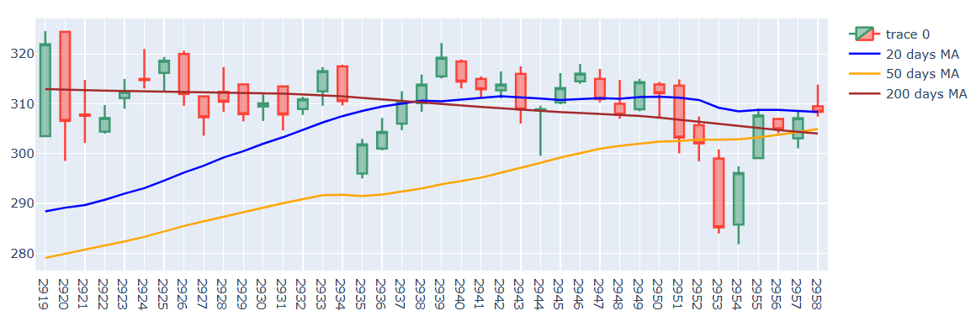
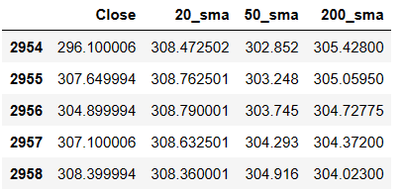
Moving Average Crossover Strategy
Vedanta
Predicting for 2023
From the Year 2011 – 2022
BUY Signal
BUY Signal
Short term crossing long term from below
Short term crossing long term from below
BUY Signal!!

Slide 50
Moving Average Crossover Strategy
Vedanta
Insight
Predicting for 2023
Company | BUY/SELL
Coal India | BUY/SELL
HindalCo | BUY/SELL
JSW Steel | SELL
Tata Steel | BUY
Vedanta | BUY
From the Year 2011 – 2022
BUY Signal
BUY Signal
Short term crossing long term from below
Short term crossing long term from below
BUY Signal!!

Slide 51
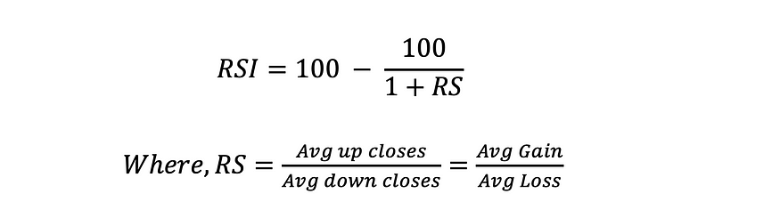
Moving Average Crossover Strategy
Relative Strength Index
Vedanta
Predicting for 2023
It is used to analyse the momentum of a stock. It compares the recent gains with the recent losses. It gives an indication on the oversold or overbought condition of a stock.
From the Year 2011 – 2022
BUY Signal
Short term crossing long term from below
BUY Signal
Short term crossing long term from below
If RSI < 30 indicates a oversold condition – BUY Signal
If RSI > 70 indicates a overbought condition – SELL Signal
BUY Signal!!

Slide 52
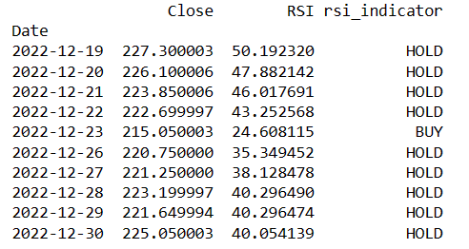
Relative Strength Index
Coal India
It is used to analyse the momentum of a stock. It compares the recent gains with the recent losses. It gives an indication on the oversold or overbought condition of a stock.
From the Year 2011 – 2022
If RSI < 30 indicates a oversold condition – BUY Signal
If RSI > 70 indicates a overbought condition – SELL Signal

Slide 53
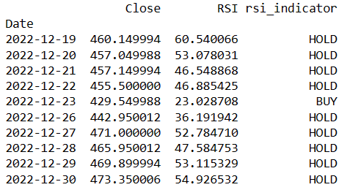
Relative Strength Index
Coal India
HindalCo
It is used to analyse the momentum of a stock. It compares the recent gains with the recent losses. It gives an indication on the oversold or overbought condition of a stock.
From the Year 2011 – 2022
If RSI < 30 indicates a oversold condition – BUY Signal
If RSI > 70 indicates a overbought condition – SELL Signal

Slide 54
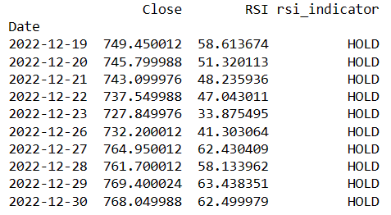
Relative Strength Index
Coal India
JSW Steel
It is used to analyse the momentum of a stock. It compares the recent gains with the recent losses. It gives an indication on the oversold or overbought condition of a stock.
HindalCo
From the Year 2011 – 2022
If RSI < 30 indicates a oversold condition – BUY Signal
If RSI > 70 indicates a overbought condition – SELL Signal

Slide 55
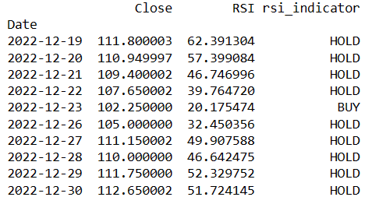
Relative Strength Index
Coal India
JSW Steel
Tata Steel
It is used to analyse the momentum of a stock. It compares the recent gains with the recent losses. It gives an indication on the oversold or overbought condition of a stock.
HindalCo
From the Year 2011 – 2022
If RSI < 30 indicates a oversold condition – BUY Signal
If RSI > 70 indicates a overbought condition – SELL Signal

Slide 56
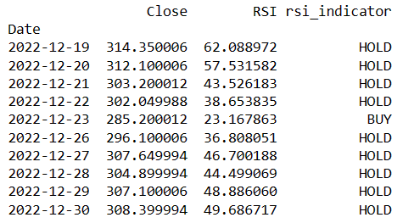
Relative Strength Index
Coal India
Vedanta
JSW Steel
It is used to analyse the momentum of a stock. It compares the recent gains with the recent losses. It gives an indication on the oversold or overbought condition of a stock.
HindalCo
Tata Steel
From the Year 2011 – 2022
If RSI < 30 indicates a oversold condition – BUY Signal
If RSI > 70 indicates a overbought condition – SELL Signal

Slide 57
Coal India
Relative Strength Index
JSW Steel
Insight
Company | Date | BUY/SELL
Coal India | 2022-12-23 | BUY
HindalCo | 2022-12-23 | BUY
JSW Steel | - | HOLD
Tata Steel | 2022-12-23 | BUY
Vedanta | 2022-12-23 | BUY
It is used to analyse the momentum of a stock. It compares the recent gains with the recent losses. It gives an indication on the oversold or overbought condition of a stock.
HindalCo
Tata Steel
From the Year 2011 – 2022
If RSI < 30 indicates a oversold condition – BUY Signal
If RSI > 70 indicates a overbought condition – SELL Signal
Vedanta

Slide 58
2022
The government has announced their commitment to enhancing infrastructure as part of their plan for current year.
Which Company to select?
Company | Economic Crisis | Volatility | Risk | BUY/SELL | BUY/SELL
Coal India | Strong | Low | Low | BUY/SELL | BUY
Hindal Co | Weak | 2nd High | 2nd High | BUY/SELL | BUY
JSW Steel | Weak | 3rd High | 3rd High | SELL | HOLD
Tata Steel | Weak | 4th High | 4th High | BUY | BUY
Vedanta | Weak | High | High | BUY | BUY
Coal India
HindlCo
JSW Steel
Tata Steel
Vedanta

Slide 59
2022
The government has announced their commitment to enhancing infrastructure as part of their plan for current year.
Which Company to select?
Company | Economic Crisis | Volatility | Risk | BUY/SELL | BUY/SELL
Coal India | Strong | Low | Low | BUY | BUY
Coal India
Company selected

Slide 60
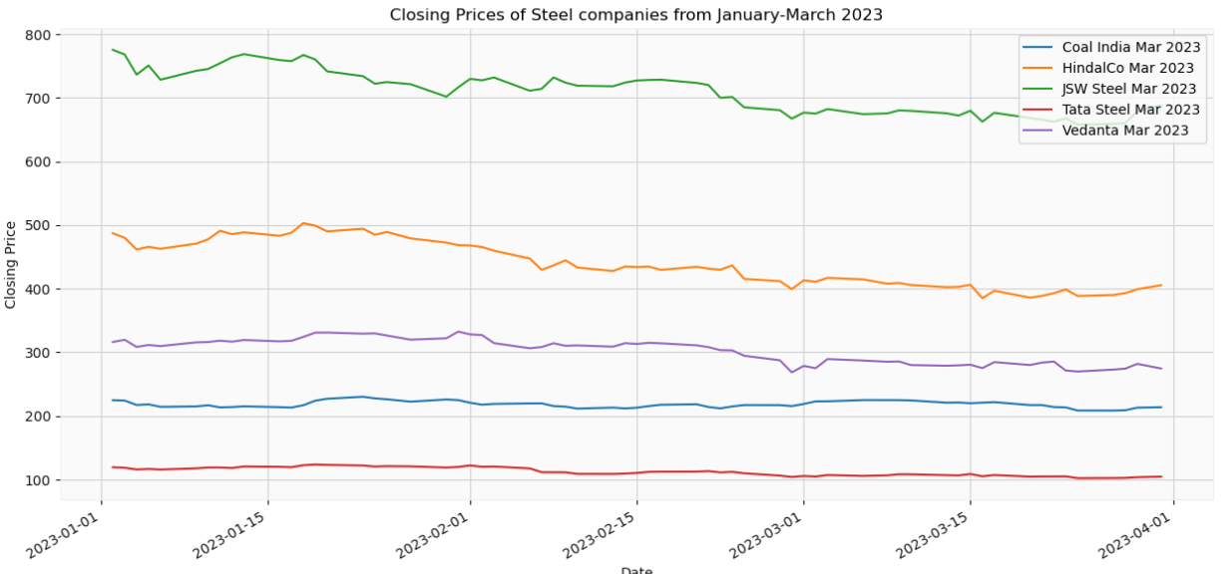
Analysis Verification
Coal India

Slide 61

MACHINE LEARNING
Predicting the future is not Magic!! ☺

Slide 62
MACHINE LEARNING
Machine Learning enables computers to learn from and make predictions or decisions based on data, without being explicitly programmed for each task.

Slide 63
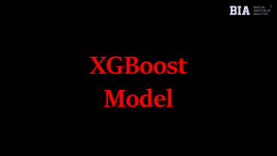
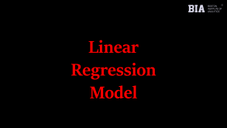
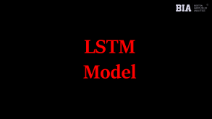

MACHINE LEARNING

Slide 64
Linear Regression Model

Slide 65
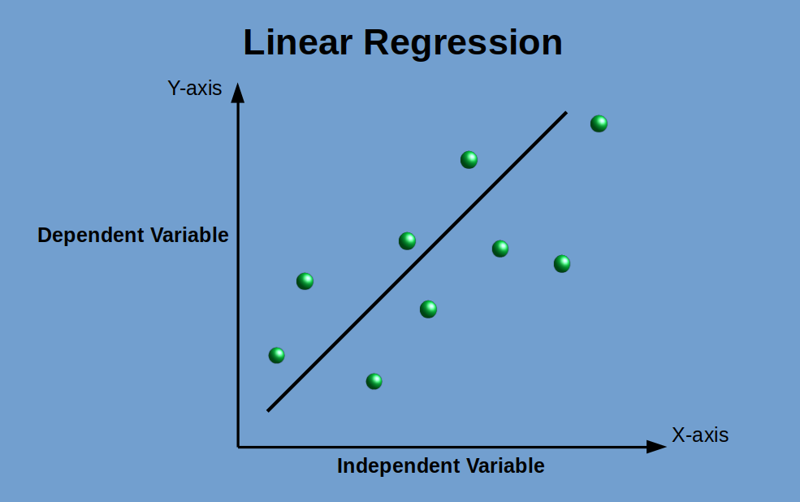
Linear Regression Model
Linear regression is a supervised learning algorithm used for predicting a continuous target variable based on one or more input features. It assumes a linear relationship between the input features and the target variable. The goal of linear regression is to find the best-fitting line that minimizes the sum of squared differences between the predicted and actual values.

Slide 66
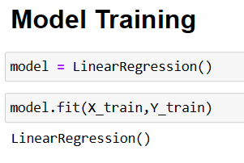
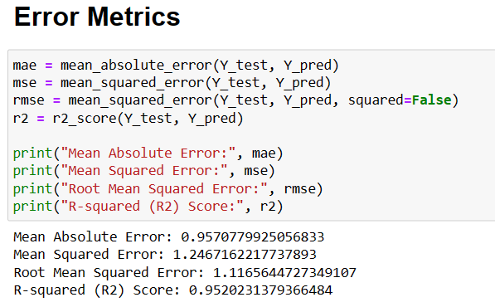
Linear Regression Model
Linear regression is a supervised learning algorithm used for predicting a continuous target variable based on one or more input features. It assumes a linear relationship between the input features and the target variable. The goal of linear regression is to find the best-fitting line that minimizes the sum of squared differences between the predicted and actual values.

Slide 67
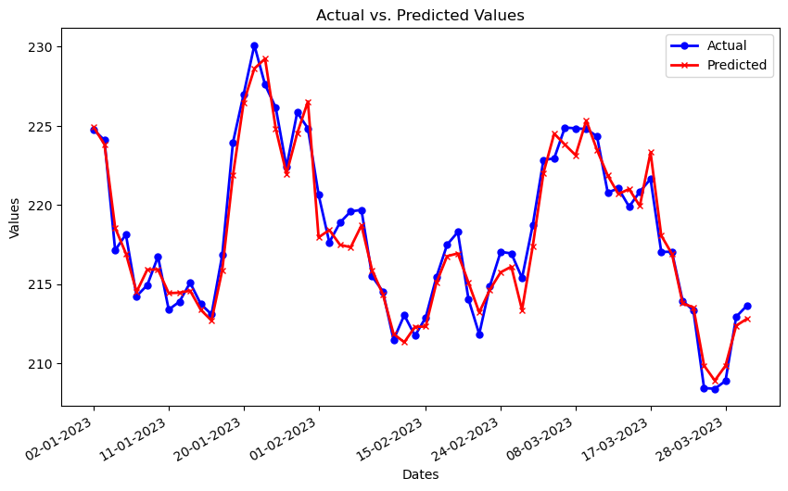
Linear Regression Model

Slide 68
LSTM Model

Slide 69
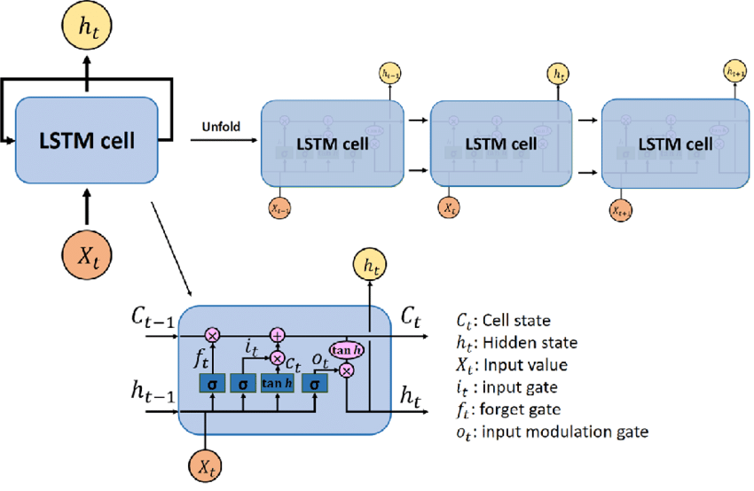
LSTM Model
LSTM stands for Long Short-Term Memory, and it is a type of recurrent neural network (RNN) designed to handle sequential data with long-term dependencies.

Slide 70
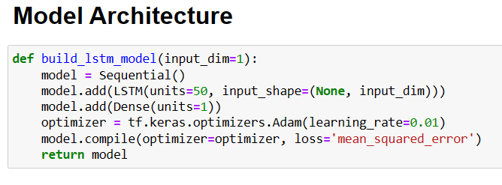
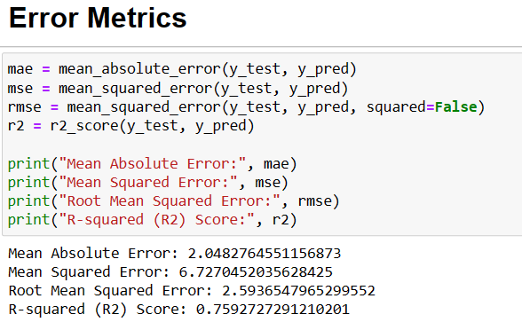
LSTM Model
LSTM stands for Long Short-Term Memory, and it is a type of recurrent neural network (RNN) designed to handle sequential data with long-term dependencies.

Slide 71
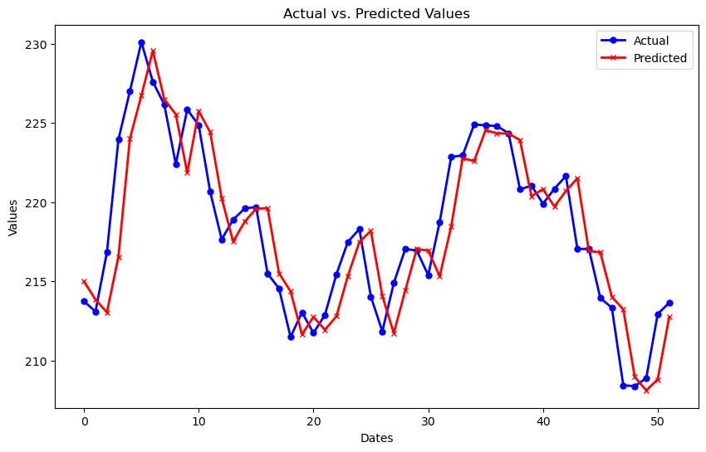
LSTM Model

Slide 72
XGBoost Model

Slide 73

XGBoost Model
XGBoost stands for Extreme Gradient Boosting, and it is a powerful machine learning algorithm that belongs to the family of gradient boosting algorithms which combines weak learners (usually decision trees) into a strong learner. It iteratively builds decision trees, focusing on the mistakes of the previous trees, and assigns higher weights to those instances, leading to a more accurate ensemble model.

Slide 74


XGBoost Model
XGBoost stands for Extreme Gradient Boosting, and it is a powerful machine learning algorithm that belongs to the family of gradient boosting algorithms which combines weak learners (usually decision trees) into a strong learner. It iteratively builds decision trees, focusing on the mistakes of the previous trees, and assigns higher weights to those instances, leading to a more accurate ensemble model.

Slide 75

XGBoost Model

Slide 76
ARIMA Model

Slide 77

ARIMA Model
ARIMA (AutoRegressive Integrated Moving Average) is a popular time series forecasting model used to predict future values based on past observations. It is a powerful and flexible model that can handle a wide range of time series data

Slide 78


ARIMA Model
ARIMA (AutoRegressive Integrated Moving Average) is a popular time series forecasting model used to predict future values based on past observations. It is a powerful and flexible model that can handle a wide range of time series data

Slide 79

ARIMA Model

Slide 80



ARIMA Model

Slide 81

ARIMA Model

Slide 82
Model Comparison Table
ARIMA Model
Model | MAE | MSE | RMSE | R2 SCORE
Linear Regression | 0.95 | 1.24 | 1.11 | 0.95
LSTM | 2.04 | 6.72 | 2.59 | 0.75
XGBoost | 1.50 | 3.65 | 1.91 | 0.85
ARIMA | 4.85 | 35.70 | 5.97 | -0.37
BEST MODEL

Slide 83
CONCLUSION
In conclusion, this stock market analysis project involved technical analysis and the implementation of four machine learning models: Linear Regression, LSTM, XGBoost, and ARIMA model. Among these models, Linear Regression emerged as the top performer with an impressive R2 score of 0.95, showcasing its ability to capture the linear relationship between input features and stock prices effectively. The combination of technical analysis and machine learning techniques offered valuable insights into the stock market's behaviour and provides investors with informed decision-making capabilities.

Slide 84
Questions??

Slide 85
Thank You!!

